Slide 1
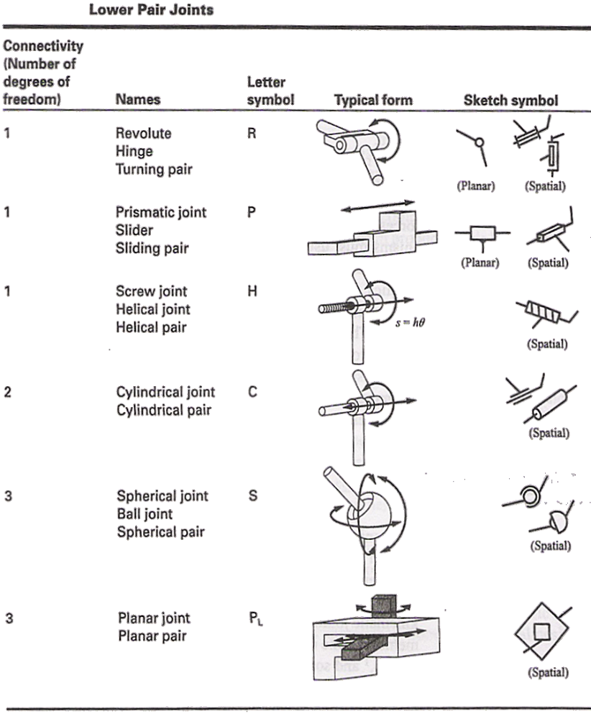
Types of Joints : Lower Pairs

Slide 2
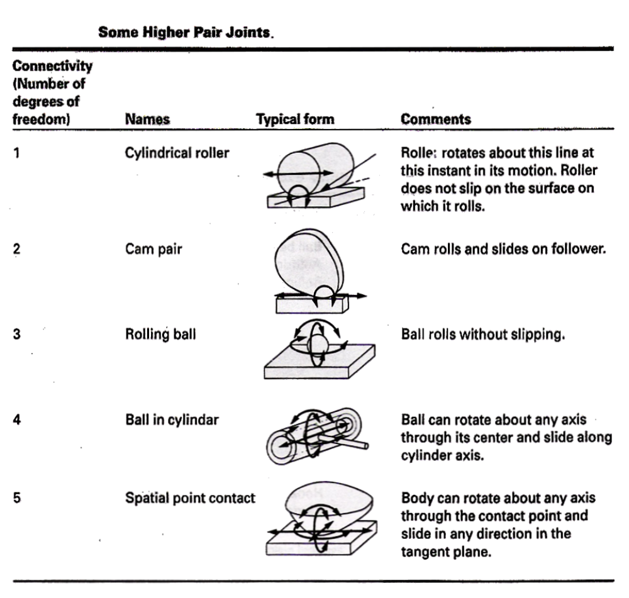
Types of Joints : Higher Pairs

Slide 3
Compound joints and reduction

